Slide 1


IIR&FIR Filter – VGA – Audio synchronized Lights
Advanced Digital Systems
ECET 349
Final Project
Kian David Warias

Slide 2

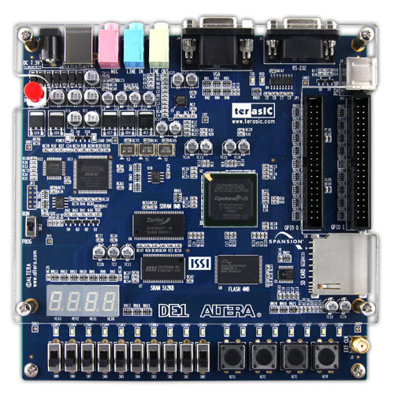



Introduction What is the project about. A technical overview.
3 Filters : IIR – low and high pass for treble and bass enhancement
FIR – moving average filter
8 LED’s : Display music output with 8 LEDs on DE1 board
VGA : Display current selected filter on VGA screen
Selected Filter
filter0
Media Input
Music synchronized LEDs
Select filter typ; activate LEDs

Slide 3


Design approach
Cost considerations
VGA TO VGA Cable & Stereo Audio Aux Cable
$12.31
VGA TO VGA Cable & Stereo Audio Aux Cable
$119
$131.31

Slide 4
Design approach
Implemented features:
3 Filters :
IIR – low pass for bass enhancement
IIR – high pass for treble enhancement
FIR – moving average filter
8 green LEDs
Displays music output with 8 LEDs on DE1 Board
VGA
Display current selected filter on VGA screen
extend FSM from Lab9 using seperate states for each filter
Indicate selected filter/state on red LEDs.
- new Entity which uses the filter output
- use code from Lab11
- change code that the memory can hold two more images.

Slide 5
Challenges & Issues
encountered during implementation and how they were solved. Indicate how many hours you spent working on this project and the cost of any peripherals that were used.
Challenge / Issue | Solution
Implement more than one filter in filter_fsm | I extended the given fsm from Lab 9 with three additional states. A state to select the other three filter states, called filter_select. And seperate states for each filter, called filter0, filter1, filter2.
Display/Store more than one image in ROM for VGA Output | The shown image depends on the selected filter, triggerd by the switches SW1 to SW3. The used images are saved in new implemented “rom” signals of type “memory”.
Synchronize music with lights | I created new entity which breaks down the 16-bit input (left_out & right_out from filter_fsm) into a 8-bit width output vector. → I am not statisfyed with the current Solution. The function of a „real“ audio peak meter is not given yet.
I spent a whole day working on the FSM without hearing a difference after compiling. | Select correct file path (outputfile) in Progammer.

Slide 6
Block Diagram Overview
LINE OUT
LINE IN
AUXOUT
AUX IN
DE1 Board
Input filter and Music synchronized Lights
Show selected filter on Monitor
INPUT
VGAOUT
Switches
&
Reset
VGA
LED OUT
LEDG0 – LEDG7

Slide 7
Block Diagram detailed Overview
AUXOUT
DE1 Board
ENTITY INCLUDES FILTER FSM WITH 3 FILTERS
filter_fsm
ENITIES HANDEL MUSIC IN-&OUTPUT
Stream_codec
&
Stream_codec
ENTITIES DISPLAY CURRENT FILTER STATE
vga_640x480
&
vga_stripe_rom
AUX
IN
INPUT
VGAOUT
(SW, RST, CLK)
ENTITY
VISUALIZE PLAYED AUDIO
Audio_to_Led
LED OUT

Slide 8
Block Diagram more detailed Overview
CLK
DE1 Board
Not all clk connections are shown!
clk_div_VGA
clk_div
i2c_codec
AUX IN&OUT
vga_640x480
SW
IN
filter_fsm
Stream_codec
VGAOUT
vga_stripe_rom
Audio_to_Led
LED OUT
RST
All Entities are using the same reset!

Slide 9
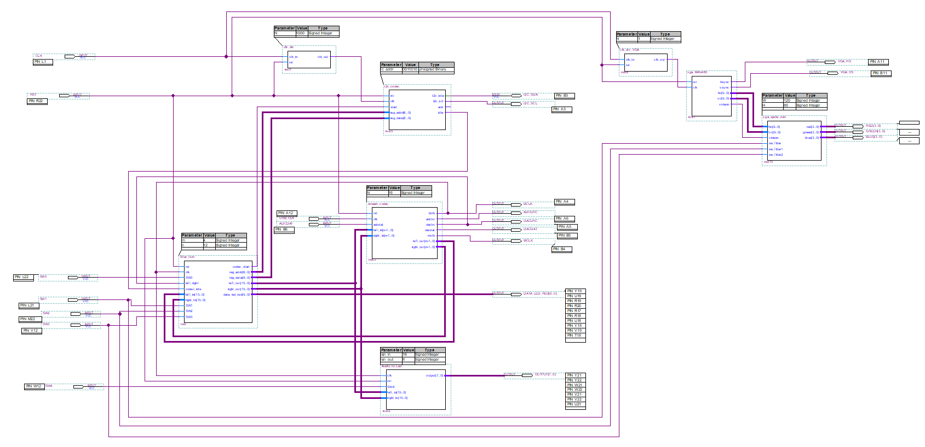
Block Diagram completed Schematic File (top.bdf)

Slide 10
Validation
AUX Output
to speaker
VGA cable from DE1 Board to Monitor
VGA Output
Monitor shows selected Filter
filter0
AUX Input
eg. connect with your PCs headphone output
LEDG0 –LEDG7
Displays Music synchronized Lights
Switches:
SW0 → Music on/off
SW1 → treble enhancement
SW2 → bass enhancement
SW3 → moving average filter
SW4 → LEDG0 –LEDG7 on/off
RESET

Slide 11
Conclusion
What you learned from this project? - Learning Outcomes
Why do it? - Societal relevance/impact and opportunity for commercialization

